Slide 1
IEEE 802.11 Overview and Amendments under development
Overview of the 802.11 Working Group
The IEEE 802.11 standard to date
New Amendments: Markets, use cases and key technologies
2022 November
Presenter:
“At lectures, symposia, seminars, or educational courses, an individual presenting information on IEEE standards shall make it clear that his or her views should be considered the personal views of that individual rather than the formal position, explanation, or interpretation of the IEEE.” IEEE-SA Standards Board Operation Manual (subclause 5.9.3)

Slide 2

IEEE Standards Association
Individual membership
Maintaining
the Standard
Initiating the
Project
7,000+ individual members in 90 countries
Corporate Memberships
Gaining Final
Approval
Mobilizing
the Working Group
  390+ member corporations in 23 countries
Standards Developers
Balloting the
Standard
Drafting the
Standard
  ~20,000 participants;
  all interested parties are welcome

Slide 3
The IEEE 802.11 Working Group is one of the most active WGs in 802
Focus on link and physical layers of the network stack
Leverage IETF protocols for upper layers
OSI Reference
Model
IEEE 802
Local and Metropolitan Area Networks
Standards Committee (LMSC)
Application
Presentation
Session
802.1
Higher
Layer
LAN
Protocols
802.3
CSMA/CD
Ethernet
802.11
Wireless
WLAN
802.15
Wireless
Specialty
Networks
802.16
Wireless
Broadband
Access
802.18
Radio
Regulatory
TAG
802.19
Co-existence
WG
802.21
Media
Independent
Handoff
802.22
Wireless
Regional
Area
Networks
802.24
Vertical
App.
TAG
Transport
Network
Data Link
IEEE
802
MAC/PHY focus
IEEE 802.11 WG Voting Members: 400+
Physical
Medium

Slide 4
Type of Groups in 802.11
Type of Group | Description
WG | Working Group
SC | Standing Committee
TG | Task Group
SG | Study Group
TIG | Topic Interest Group
AHG | Ad Hoc Group

Slide 5
IEEE 802.11 Active Subgroups
Type | Group | WG & Infrastructure
WG | WG11 | The IEEE 802.11 Working Group
SC | AANI | Advanced Access Networking Interface (AANI)
SC | ARC | Architecture
SC | COEX | Coexistence
SC | PAR | PAR review
802 SC | JTC1 | ISO/IEC JTC1/SC6
Type | Group | Amendments/Revision
TG | AZ | Next Generation Positioning (NGP)
TG | BB | Light Communication (LC)
TG | BC | Enhanced Broadcast Service (BCS)
TG | BD | Enhancements for Next Gen V2X (NGV)
TG | BE | Extremely High Throughput
TG | BF | WLAN Sensing
TG | BH | Randomized MAC Addresses (RCM)
TG | BI | Enhanced Data Privacy Protection (EDP)
TG | ME | Revision (REVme)
WG | COR1 | 802.11-2020 Corrigendum (11ay ANA)
TG | BK | 320 MHz Positioning (To be confirmed)
Type | Group | New Work
SC | WNG | Wireless Next Generation
SG | UHR | Ultra High Reliability Study Group
TIG | AIML | Artificial Intelligence/Machine Learning
TIG | AMP | Ambient Power for IoT
AHG | ITU | ITU related topics and documents

Slide 6
Development of the IEEE 802.11 Standard is ongoing since 1997
802.11
-2020
802.11
-2016
802.11
-2012
802.11
-2007
802.11
-2003
11aq
Pre Association
Discovery
11aa
Video Transport
11k
RRM
11s
Mesh
11e
QoS
MAC
11u
WIEN
11v
Network
Management
11h
DFS & TPC
IEEE
Std
802.11
-1997
11ak
General Link
11ae
QoS Mgt Frames
11z
TDLS
11i
Security
11d
Intl roaming
11ai
Fast Initial Link
Setup
11w
Management
Frame
Security
11r
Fast Roam
11f
Inter AP
11n
High
Throughput
(>100 Mbps)
11ah
Sub 1 GHz
11af
TV Whitespace
11j
JP bands
11a
54 Mbps
5GHz
PHY & MAC
11aj
China millimeter
wave
11ac -VHT
>1 Gbps @ 5GHz
11p
WAVE
11y
Contention
Based
Protocol
11g
54 Mbps
2.4GHz
11b
11 Mbps
2.4GHz
11ad - VHT
>1 Gbps @ 60GHz
Notes:
doc.: IEEE 802.11-11/0483r0
May 2011
Bruce Kraemer (Marvell)
Page 6
The 802.11 Working Group was established in 1990. The first standard was published in 1997 (2.4GHz) supporting 1 and 2 Mbps. Subsequent amendments and revisions have increased radio performance and throughput by orders of magnitude. The most recent published standards is IEEE Std 802.11-2020.
The 802.11b 11Mbps standard was the first to achieve commercial success, with the announcement by Steve Jobs at MACWorld in 2001 that the MACbook would include 802.11 radios, along with the Apple Airport. PC vendors followed suit. Describe highlights of each revision.

Slide 7
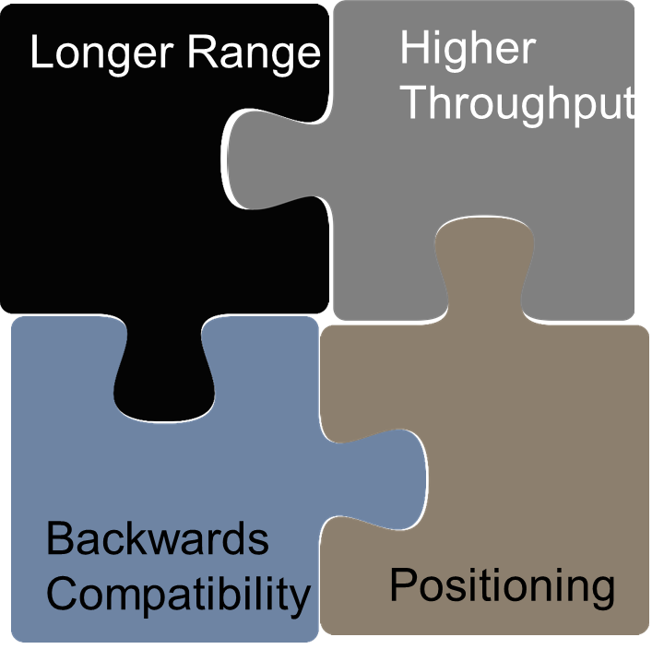
New 802.11 Radio technologies are under development to meet expanding market needs and leverage new technologies. Completed standards
IEEE Std 802.11-2020 Revision project, published February 26, 2021
IEEE Std 802.11ax-2021 – Increased throughput & efficiency in 2.4, 5 (and 6) GHz bands, published May 18, 2021
IEEE Std 802.11ay-2021 – Support for 20 Gbps in 60 GHz band, published in July 2021
802.11az – 2nd generation positioning features (Dec 2022)
IEEE Std 802.11ba-2021 – Wake up radio. Low power IoT applications, published October 2021
802.11bb – Light Communications
802.11bc – Enhanced Broadcast Service
802.11bd – Enhancements for Next Generation V2X (Dec 2022)
802.11be – Extremely High Throughput
802.11bf – WLAN Sensing
802.11bi – Randomized MAC Addresses
802.11bh – Enhanced Data Privacy
802.11bk – 320 MHz Positioning (TBC)
Notes:
The standard and amendments listed in green are approved and published.
The others are under development, link in the title is to the 802.11 website, where you can obtain more information.
All IEEE 802 standards are available for free 6 months after publication at the IEEE get802 website.
802.11-2020 is the current base standard, approved last year and published in February.

Slide 8
IEEE 802.11 Standards Pipeline – July 2022
802.11
-2020
802.11bk
320P
802.11bh
RCM
802.11
REVme
802.11bc
BCS
802.11
COR-1
AIML TIG
802.11bi
EDP
802.11az
NGP
802.11ba
WUR
ITU Liaison
(ITU) AHG
WNG
AMP TIG
802.11bf
SENS
802.11bd
NGV
802.11ax
HEW
UHR SG
802.11be
EHT
802.11bb
LC
802.11ay
NG60
Liaison
MAC & PHY
Liaison Topics
Discussion Topics
TIG/Study
groups
TG without
Approved draft
WG
Letter Ballot
SA
Ballot
Published
Amendment
Published
Standard
Notes:
doc.: IEEE 802.11-11/0483r0
May 2011
Bruce Kraemer (Marvell)
Page 8

Slide 9
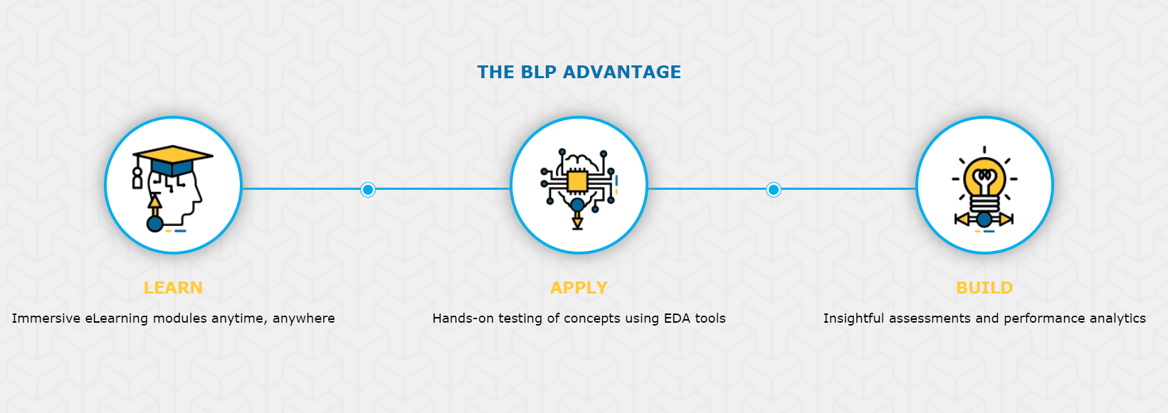
IEEE Blended Learning Program - Building Wireless Community Networks
‘Building Wireless Community Networks’ is a technician level course on Wi-Fi developed by IEEE Standards Association (IEEE SA) with Internet Society (ISoC)
The course is designed to provide the learners with
the skills needed on key aspects of wireless
networking, standards, radio physics, networking and troubleshooting to get work ready
provides a solid foundation on wireless network
Example in India: Common Services Centers (CSC), under the Ministry of Electronics and Information Technology (MeitY) and IEEE have worked together to upskill Village Level Entrepreneurs (VLE) on Building Wireless Community Networks technologies through its Blended Learning Program (IEEE BLP). 500+ VLEs have already been trained and potentially around 2000 VLEs are planned to be trained by this end of this year
https://blended-learning.ieee.org/
https://blended-learning.ieee.org/Portal/Catalog/ViewCourse/10834/Building-Wireless-Community-Networks
Notes:
Delivering technology to the market in the form of products is one critical step. Installation, operation and maintenance of the
Equipment is the next required step.
The IEEE Blended Learning Program offers a wide variety of courses on technical topics, including a new course on building wireless community networks.
<read through text on the slide>

Slide 10

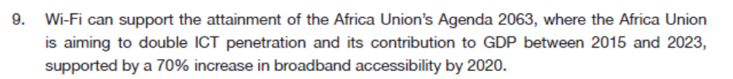
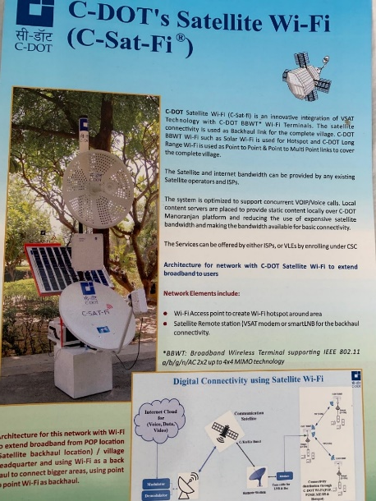
IEEE 802.11 based products are an essential component for connecting the unconnected: enabling low cost RLAN & hotspot access, rural connectivity, disaster management
Opportunity to transform the connectivity landscape for those who are currently unconnected
July 2021: Africa Telecommunication Union Recommendation 005-0 to allocate the 5925-6425 MHz band for unlicensed usage. ATU Member States are expected to update their national regulations accordingly.
Certainty of regulation provides the foundation for industry action to more quickly meet development goals
Use cases: Hotspot access, Community Wi-Fi using satellite, optical for backhaul
Backhaul Connectivity Initiatives in India – Optical Fiber deployed along railways + Wi-FI connectivity
Backhaul Initiatives in Africa: Optical Fiber along highways, + Wi-Fi Hotspot access

Slide 11

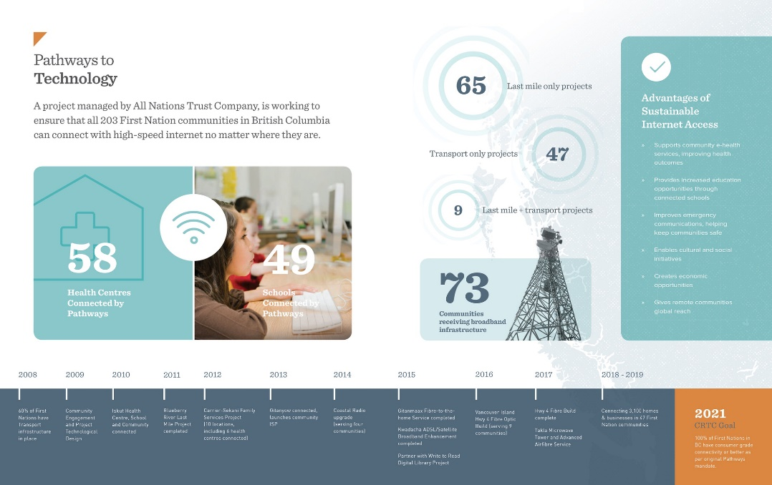
Wi-Fi networks are being deployed globally to provide Broadband access, using wired and wireless backhaul
  In India for Broadband Access, Disaster response
  Smart Villages in Niger connected via satellite and Wi-Fi Smart Africa).
  Provision of fast, affordable, and reliable access to the internet over Wi-Fi in Rwanda, South Africa, Ghana, and Nigeria
  Wi-Fi reach for schools: Enabling e-learning in Mali
  Wi-Fi Community networks, https://villagetelco.org/deployments/mankosi-south-africa/
  AND in rural, underserved areas in developed countries, see for example Canada First Nations project, https://www.pathwaystotechnology.ca/about/infographic

Slide 12

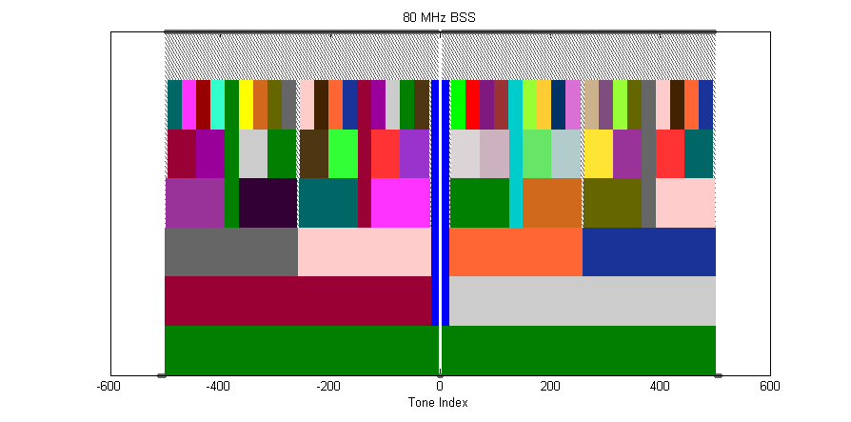
Products implementing 802.11ax-2021 are in the market now: Wi-Fi 6, 6E
2022: 2.3 Billion Wi-Fi 6 devices, 350 Million Wi-Fi 6E, 4.4 Billion devices total
Spectral Efficiency & Area Throughput
High Density
DL/UL MU-MIMO
w/ 8 clients
OFDMA
1024 QAM
25% increase
in data rate
Long OFDM
Symbol
Spatial Reuse
ac
ax
8x8 AP
2x increase
in throughput
Up to 20%
increase
in data rate
Power Saving
Outdoor / Longer range
Scheduled sleep and wake times
Extended range packet structure
20 MHz-only clients
Enhanced delay
spread protection-
long guard interval
0.8us 11ac
1.6us 11ax
3.2us 11ax
Notes:
The key areas of technical focus in the 802.11ax standard are increased spectral efficiency and improved throughput in a given area, support for high density applications, improved power save performance and improved outdoor and long range performance.

Slide 13
New 802.11 Radio technologies are under development to meet expanding market needs and leverage new technologies.
802.11az – 2nd generation positioning features
802.11bb – Light Communications
802.11bc – Enhanced Broadcast Service
802.11bd – Enhancements for Next Generation V2X
802.11be – Extremely High Throughput
802.11bf – WLAN Sensing
802.11bi – Randomized MAC Addresses
802.11bh – Enhanced Data Privacy
802.11bk – 320 MHz Positioning (TBC)
Ultra High Reliability Study Group
AI/ML Topic Interest Group
Ambient Power for IOT Topic Interest Group
Notes:
This is a list of the amendments that are currently under development in the 802.11 Working Group.
The next slides will present a brief overview of the 802.11 Light Communications and Enhanced Broadcast Service standards that are under development.
Two new Topic Interest Groups were formed in 2022 May, and will begin meeting. These are on the topics of
Artificial Intelligence/Machine learning in 802.11 systems, and Ambient power for 802.11 based IoT devices.

Slide 14
IEEE802.11 Wi-Fi standard evolution: 802.11be is under development
802.11n (2009)
Wi-Fi 4
802.11ac (2013)
Wi-Fi 5
802.11ax (2021)
Wi-Fi 6 6E
802.11be (est. 2024)
Wi-Fi 7
2.4GHz and 5GHz supported
Wider channels (40MHz)
Better modulation (64-QAM)
Additional streams (Up to 4)
Backward compatibility with 11a/b/g
Standard supports up to 600Mbps
5GHz only
Wider channels (80, 160MHz)
Better modulation (256-QAM)
Additional streams (Up to 8, implemented up to 4)
Backward compatibility with 11a/b/g/n
Standard supports up to 7Gbps
2.4GHz, 5GHz and 6GHz supported
Wider channels (80, 160MHz)
Better modulation (1024-QAM)
Additional streams (Up to 8, implemented)
Backward compatibility with 11a/b/g/n/ac
Standard supports up to 9.6Gbps
2.4GHz, 5GHz and 6GHz supported
Wider channels (40, 80, 160, 240, 320MHz)
Better modulation (4096-QAM)
Backward compatibility with 11a/b/g/n/ac/ax
Throughput minimum of 30Gbps, expect 40Gbps+
Low latency features
Draft 2.0 now in Working Group Ballot
(Ratification date) Products available in the market typically ~2 years prior

Slide 15
Market demands and new technology drive IEEE 802.11 innovation
Demand for throughput
  Continuing exponential demand for throughput (802.11ax and 802.11ay, 802.11be)
  Most (50-80%, depending on the country) of the world’s mobile data is carried on 802.11 (Wi-Fi) devices
New usage models / features
  Dense deployments (802.11ax), Indoor Location (802.11az, 802.11bk),
  Automotive (IEEE Std 802.11p, Next Gen V2X), Internet of Things (802.11ah)
  Low Power applications (802.11ba)
  WLAN Sensing (802.11bf)
Technical capabilities
  MIMO (IEEE Std 802.11n, 802.11ac, 802.11ay) and OFDMA (802.11ax)
  60 GHz radios (802.11ay)
Changes to regulation
  TV whitespaces (IEEE Std 802.11af), Radar detection (IEEE Std 802.11h), 6GHz (802.11ax, 802.11be)
  Coexistence and radio performance rules (e.g., ETSI BRAN, ITU-R)
Notes:
This summarizes the market demands - what are the market forces and new technology that underpin innovation in 802.11.
First and foremost, the demand for increased throughput are neve-ending. AX, AY, EHT support this.
Most of world’s mobile data are carried by wi-fi devices that connected to access networks. New usage models and features, motivates new amendments. Such as Dense Deployments, Indoor location, Automotive, Low Power applications.
Increase in technical capabilities also drives new standards. Technologies like MIMO and OFDMA are incorporated into new standards when they are available.
So does changes to regulation that enable development for new standards.

Slide 16



802.11az Next Generation Positioning
The P802.11az project Next Generation Positioning extends accurate IEEE Std 802.11-2016 Fine Timing Measurement capabilities
Accurate indoor Navigation (sub 1m and into the <0.1m domain).
Enables self-locating networks for easy, fast and cost efficient WLAN deployment for navigation and 6GHz AFC operation.
Secured (authenticated and private) positioning – open my car with my smartphone, position aware services (money withdrawal).
Unlock computer with a wearable device, adapt TV content to audience presence.
Location based link adaptation for home usages (connect to best AP).
Navigate in extremely dense environments (stadium/airport scenarios).
16

Slide 17
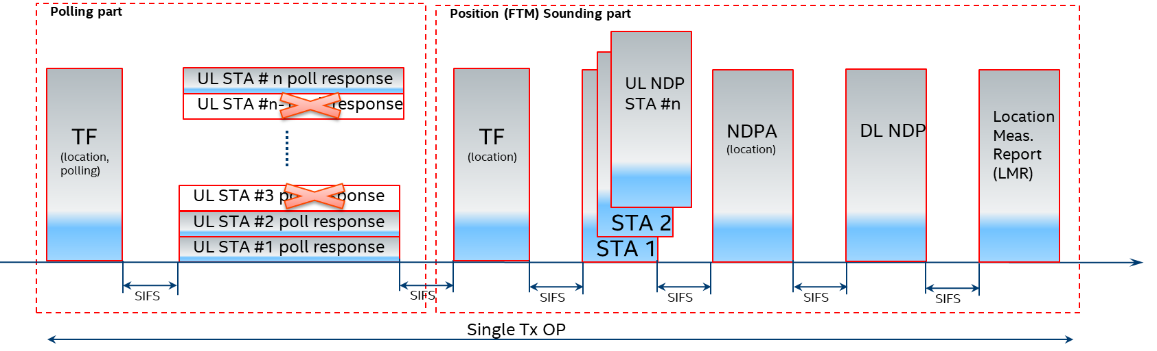
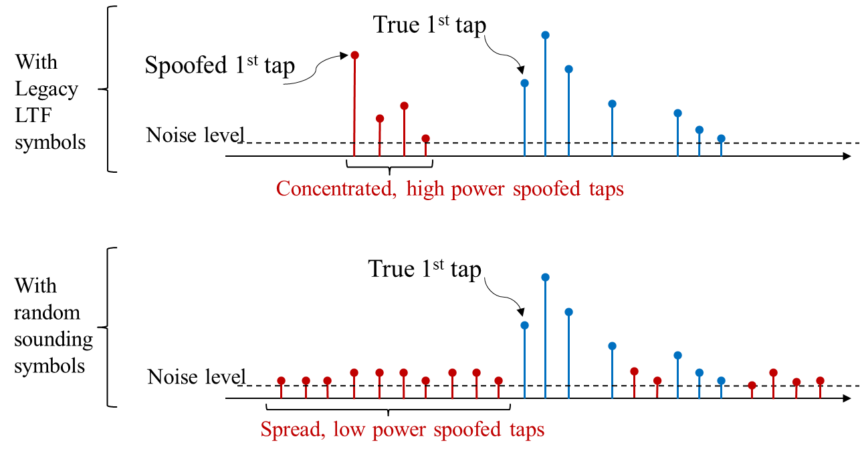
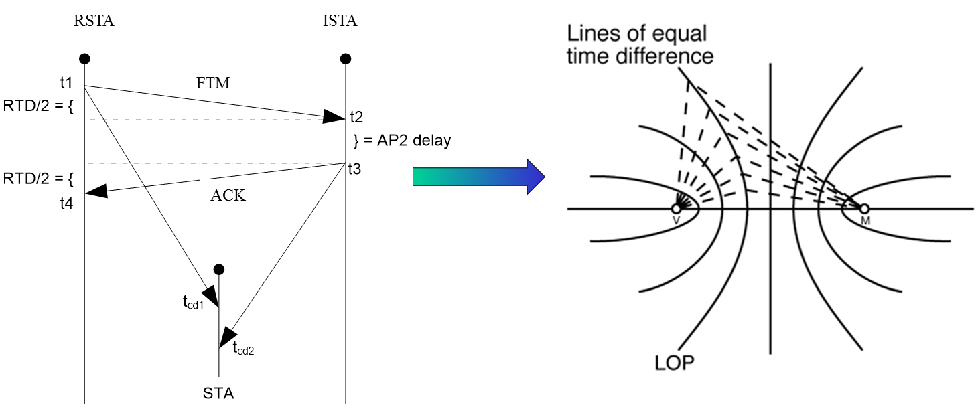
802.11az Key Radio and Positioning Techniques
Medium efficient operation via dynamic (demand dependent) measurement rate
Adaptation to next generation mainstream 802.11ax Trigger Based Operation (MIMO, Trigger Frame, NDP frame)
Authenticity and privacy and anti-spoofing mechanism via PMF in the unassociated mode and PHY level randomized measurement sequences (HE LTF sequences protection)
Improved accuracy via MIMO and larger BW available in the <7Ghz band for 11ax
MIMO enablement for measurement for improved accuracy especially for NLOS or NNLOS conditions
Passive location with fixed overhead independent of number of users

Slide 18
802.11bb Light Communications
Light Communications (LC)
  Ability to re-use existing HT, VHT and HE PHY/MAC
Use Cases:
  Industrial wireless applications
  Medical environments
  Enterprise
  Home
  Backhaul
  Vehicle to Vehicle Communication
  Underwater Communication
  Gas Pipeline Communication
Key additions :
  Uplink and downlink operations in
  800 nm to 1000 nm band
  Minimum single-link throughput
  of 10 Mb/s
  Interoperability among solid state
  light sources with different
  modulation bandwidths.
18

Slide 19
802.11bb transports defined 5/6GHz MAC/PHY across the light channel
5/6 GHx 802.11 MAC and PHY are used as defined today
A Physical Layer Protocol Data Unit (PPDU) is converted to light using intensity modulation. At the receiver, the optical signal is converted to an electrical signal. LC systems transmit on wavelengths within the 800nm to 1000 nm band.
802.11
MAC
802.11
MAC
Existing
PHY for LC
LC
TX/RX
LC
TX/RX
Existing
PHY for LC

Slide 20
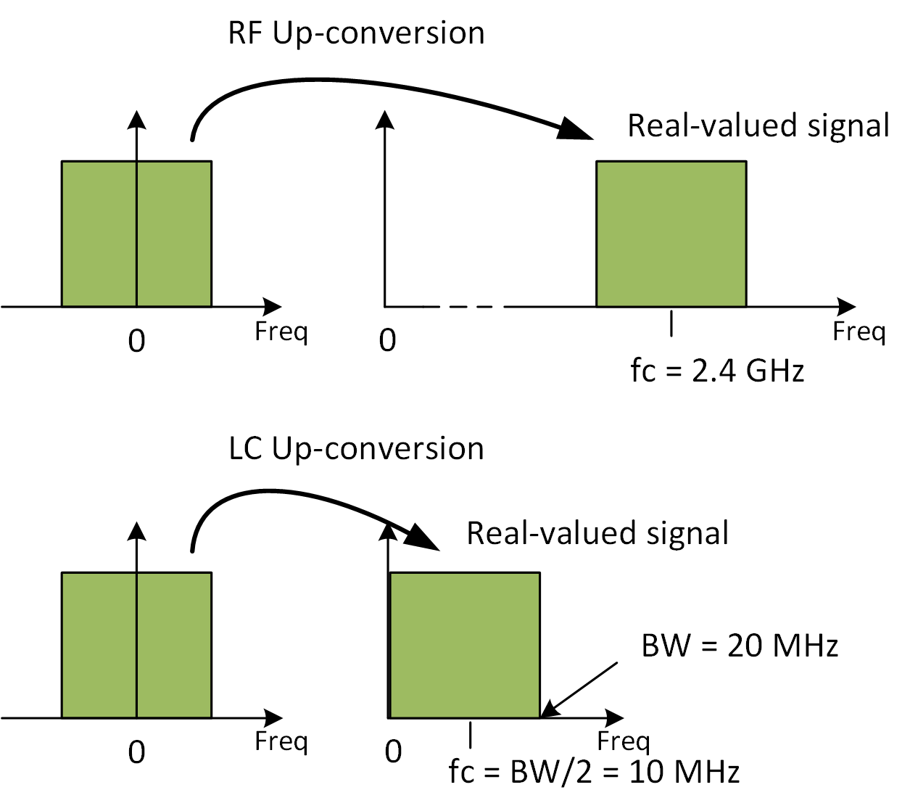
802.11bb uses light spectrum and existing WLAN capabilities
RF frontend up-converts
baseband signals onto e.g.
f_{c}= 5 GHz.
LC frontend up-converts
baseband onto low IF e.g.
f_{c}= BW/2 + Δ.
  Δ is specified in the existing draft of TGbb for various channel bandwidths.
In this manner, LC re-uses the existing HT, VHT and HE PHY/MAC specifications.
5 GHz
BW/2 + Δ MHz

Slide 21
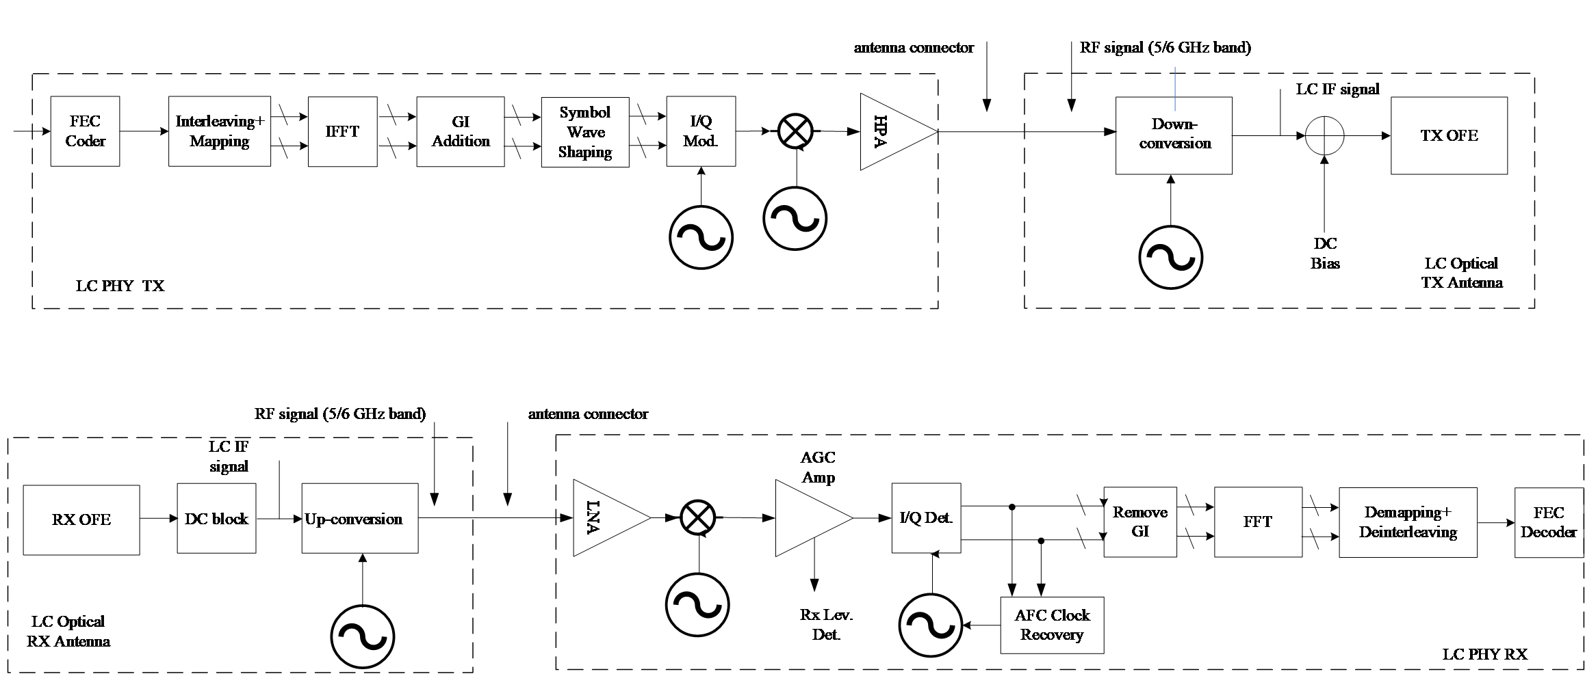
802.11bb uses light spectrum and existing 802.11 technical capabilities
Example implementation of P802.11bb using up- and down-conversion of existing 5 GHz or 6 GHz chipsets
Interfacing the LC PHY to light emitter and receiver.

Slide 22
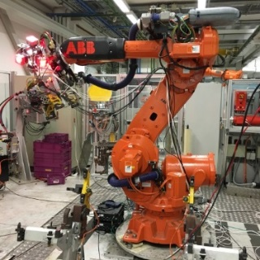
802.11bb usage model 1: Industrial wireless
Pre-Conditions
Devices may experience unstable radio frequency (RF) connection due to Electro-Magnetic Interference (EMI) in factories. LC is deployed to provide reliable wireless connectivity for industrial wireless networks.
Environment
All communications are within a large metal building, industrial or automated work cell. The area of these environments range from tens to thousands of square meters, equipped with industrial robot and other equipment. The environment has high levels of EMI. Lighting level of 150 lux is recommended (1500 lux for dedicated work).
Applications
Ultra-high-definition (UHD) video streaming for surveillance or production monitoring (quality control) applications, for video collaboration for team, customer, and supplier meetings. Lightly compressed Video: ~ 1Gbps, delay < 5 ms, 1x10⁻⁸ PER, 99.9% reliability. Fully connected factory—for real-time communications, application execution, and remote access.Distance between LC APs ranges from 2~20 meters.
Traffic Conditions
Both uplink and downlink traffic is using LC.
High levels of OBSS interference between LC access points (APs) expected due to very high density deployment.
Potential non-LC interference from surrounding environments such as artificial-light.
Multiple LC modules are deployed on the robot/equipment and on the ceiling/walls to provide multiple light links for a robust connectivity in case a single line-of-sight (LOS) link is blocked.
Use Case
An industrial robot is powered on and ready for operation.
Operating instructions are transmitted to the robot via LC.
The robot is working (e.g., movement) according to the instructions and provides real-time feedback information and/or video monitoring data for quality control to control center also via LC. Upon command, the robot finishes the task and is ready for the next one.
22

Slide 23
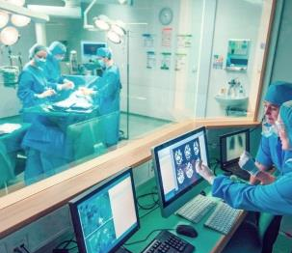

802.11bb usage model 2: Wireless access in medical environments
Pre-Conditions
IEC 60601-1-2 standard recommends the minimum separation distance between medical electrical (ME) equipment and RF wireless communications equipment (e.g., wireless local area network (WLAN)) be 30 cm to avoid performance degradation of the ME equipment. LC is deployed to ensure the performance of all ME equipment.
Environment
The size of a operating theater and MRI room ranges from 30~60 m². Multiple LC-APs are deployed on the ceiling to provide specialized illumination. The central illuminance of the operating light: 160k and 40k lux. The size of a four beds ward is about 60 m², light level: 300 lux on the bed and >100 lux between the beds and in the central area.
Applications
LC-WLAN is used to allow wireless data exchange in medical environments with ME equipment or system.
Medical multimedia and diagnostic information can be transmitted to provide telemedicine services; ME equipment can also be wirelessly controlled via LC.
Provide Intranet/ Internet access, audio or video call for doctors, nurses and patients using LC-based devices.
Traffic Conditions
No interference caused by RF radiation.
Both uplink and downlink traffic is are using LC.
High Quality of Service (QoS) and high reliability are required.
Potential non-LC interference from surrounding environments such as artificial-light.
Use Case
Doctors enter an operating theater, turn on the LC enabled LED lights and ME equipment. Doctors can interact with the remote doctors and share information using LC. ME equipment connectivity is also supported by LC. Doctors finish the treatment, then turn off the lights and medical equipment.
A patient is monitored by ME equipment which communicate with the nurses/doctors in control room via LC.
© vm
Operating theater
Hospital ward

Slide 24
802.11bc is defining Enhanced Broadcast Services
Enhanced Broadcast Services (eBCS) defines broadcast service enhancements within an 802.11-based network.
Client end devices broadcast information to an AP, e.g. in an IoT environment, to other STAs so that any of the receiving APs act as an access node to the Internet.

Slide 25
802.11bc Broadcast Downlink use case description
Broadcast Downlink
  Provides enhanced Broadcast Services (eBCS) of data (e.g. videos) to a large number of densely located STAs.
  These STAs may be associated, or un-associated with the AP or may be low-cost STAs that are receive only.
Topology/Architecture
Contents
Server
Network
AP
STA
STA
STA
STA
STA

Slide 26






802.11bc Broadcast Uplink use case description
Broadcast Uplink
  Pre-configured devices (e.g. IoT) automatically connect to the end server through APs with zero setup action required.
  Alternatively, low power IoT devices that are in motion, report to their servers through APs without scanning and associating
Topology/Architecture
STA 1
AP 1
Internet
Server
AP 2
Zero Setup Sensor
STA 2
STA 1
@ t=T₁
AP 1
Internet
Server
Sensor on the move
STA 1
@ t=T₂
AP 2

Slide 27




802.11bd defines an evolution of 802.11p for Vehicle to Anything (V2X)
802.11p is largely based on 802.11a.
802.11bd defines MAC/PHY enhancements from 802.11n, ac, ax, to provide a backwards compatible next generation V2X protocol.
Higher Throughput
  OFDM frame design
  Higher MCS, LDPC coding
  Packet aggregation
Longer Range
  Mid-amble design
  Repeated transmission mechanism
  More robust channel coding
Support for Positioning
Backward Compatibility
  Backward compatible frame format design, Version indication
Longer Range
Higher Throughput
Backwards Compatibility
Positioning

Slide 28
802.11bd: Next Generation V2X Use Cases
5.9 GHz band mainly, and optionally 60 GHz;
Completion in 2022/2023
http://www.ieee802.org/11/Reports/tgbd_update.htm
V2X Use Cases:
  Suport all defined DSRC/802.11p use cases, including
  Basic safety message (safety, range, backward
  compatibility, fairness)
  Sensor sharing (throughput)
  Multi-channel operation (safety channel +
  other channels)
  Infrastructure applications (throughput)
  Vehicular positioning & location (LoS and
  NLoS positioning accuracy)
  Automated driving assistance (safety, throughput)
  Aerial vehicle IT application (video)
  Train to train (high speed)
  Vehicle to train (high speed, long range)
Key additions :
  Higher throughput (2x) than 802.11p
  Longer range (3dB lower sensitivity level)
  Support for positioning
  Backward compatibility with 11p
28

Slide 29
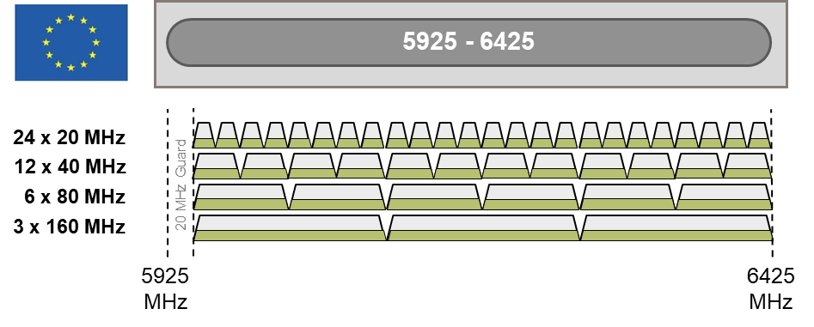


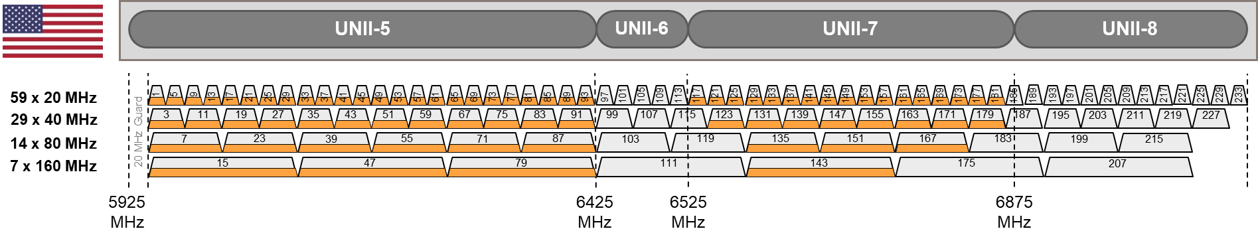
802.11be Extremely High Throughput amendment builds on 802.11ax, including 6GHz support
Use Cases:
  Home, enterprise, industrial, IoT
  Outdoor
  AR/VR, wireless gaming
  4K and 8K video streaming
  Remote office
  Cloud/edge computing
  Video calling and conferencing
Extremely High Throughput (EHT)
Operation in 2.4 GHz, 5 GHz, and 6 GHz bands
Higher throughout – Project goal of at least
30 Gbps; expect 40+Gbps with 320MHz channels,
4096 QAM
Support for low latency communications
Continued improvements in spectral efficiency
Targeted completion in 2024

Slide 30
802.11be features under consideration
  Support of 320 MHz bandwidth channels, enabling extremely high throughput use cases
  More efficient utilization of non-contiguous spectrum
  Multi-band/multi-channel aggregation and operation
  MIMO protocol enhancements, enhanced sounding protocol
  Multi-AP Coordination (e.g. coordinated and joint transmission)
  Refinements of 802.11ax features: Multiple Resource Unit operation
  Target Wait Time (TWT) enhancements
  GCMP-256 support
  Adaptation to regulatory rules specific to 6 GHz spectrum
  NSEP priority access operation

Slide 31
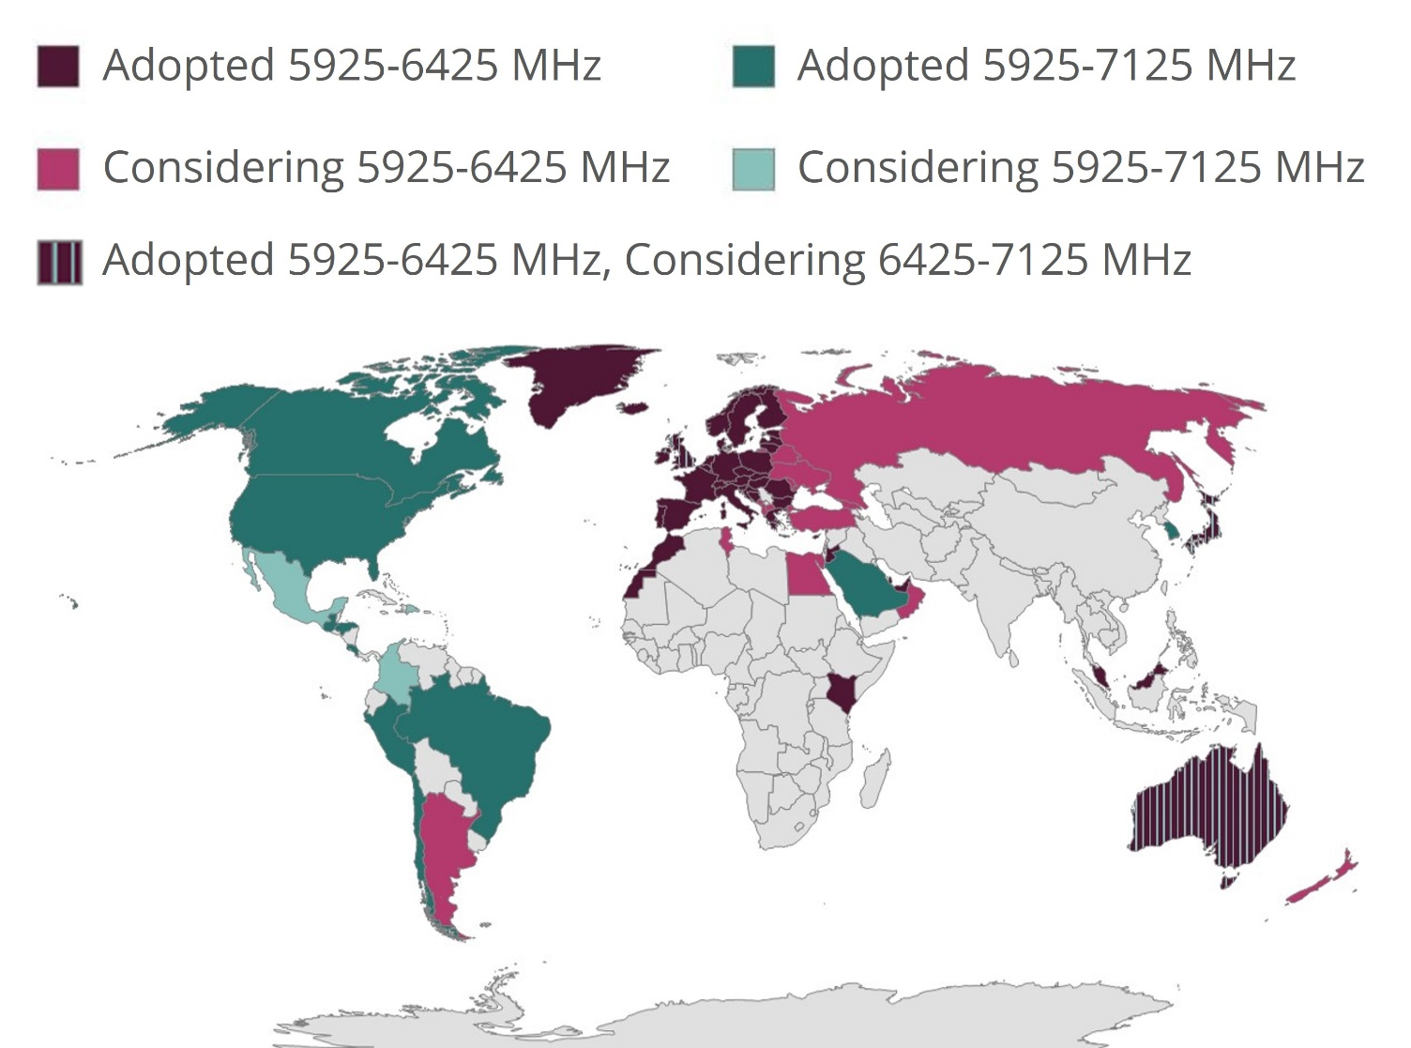
Countries enabling Wi-Fi 6E: 6GHz Operation, see https://www.wi-fi.org/countries-enabling-wi-fi-6e (as of 2022-07-31)
Notes:
The map shows the countries that have enabled or are considering enabling 6GHz operation for Wi-Fi services.

Slide 32
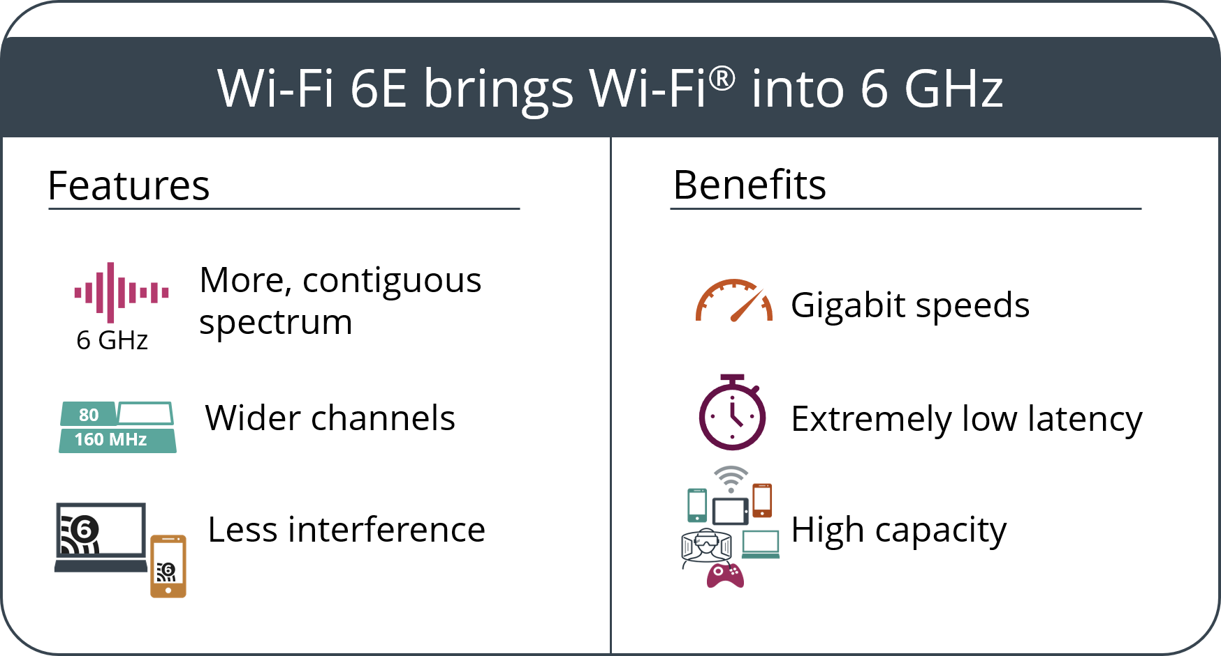
WFA Wi-Fi 6E Interoperability certification is now available: IEEE 802.11ax in the 6GHz band
Certification Announced 2021-01-07
Press release
Paper: Wi-Fi 6E: Wi-Fi® in the 6 GHz band
Wi-Fi 6E Highlights
Wi-Fi 6E Video animation
List of certified devices
Notes:
Wi-Fi 6E is the Wi-Fi Alliance marketing term for support of 802.11ax in the 6GHz band.
About 5 years ago, a spectrum needs study for Wi-Fi applications was performed, which indicated that to enable the
Anticipated growth of services and applications and support gigabits of throughput, that 1200 Megahertz of spectrum is needed.
This, coupled with the significant economic value of Wi-Fi, the need to provide ICT connectivity at affordable price points, has led many
Administrations to authorize use of the 6GHz band to unlicensed/license exempt use.
The economic value of Wi-Fi has increased in the pandemic, with Wi-Fi becoming an essential tool for connectivity.
Wi-Fi technology, with its low power operation, and listen before talk channel access supports coexistence with incumbent satellite and various fixed services in the band.
Please see the papers and materials at the links provided.

Slide 33


Detail: 6 GHz Channels in United States & Europe/CEPT
UNII-5
UNII-6
UNII-7
UNII-8
59 x 20 MHz
1
5
9
13
17
21
25
29
33
37
41
45
49
53
57
61
65
69
73
77
81
85
89
93
97
101
105
109
113
117
121
125
129
133
137
141
145
149
153
157
161
165
169
173
177
181
185
189
193
197
201
205
209
213
217
221
225
229
233
29 x 40 MHz
3
11
19
27
35
43
51
59
67
75
83
91
99
107
115
123
131
139
147
155
163
171
179
187
195
203
211
219
227
14 x 80 MHz
_{20 MHz Guard}
7
23
39
55
71
87
103
119
135
151
167
183
199
215
7 x 160 MHz
15
47
79
111
143
175
207
5925 MHz
6425 MHz
6525 MHz
6875 MHz
7125 MHz
5925 - 6425
= Low Power Indoor (LPI) Only
24 x 20 MHz
= LPI & Automatic Frequency Coordination (AFC)
12 x 40 MHz
= LPI & Very Lower Power (VLP)
6 x 80 MHz
_{20 MHz Guard}
3 x 160 MHz
5925 MHz
6425 MHz
Notes:
This slide shows the channel allocation in the EU and USA, and modes of operation.

Slide 34
802.11bf WLAN sensing
WLAN sensing is the use of received WLAN signals to detect features of an intended target in a given environment.
  Measure range, velocity, angular, motion, presence or proximity
  Detect objects, people, animals
  Use in room, house, car, enterprise environments
Target frequency bands are:
  between 1 GHz and 7.125 GHz (MAC/PHY service interface)
  above 45 GHz (MAC/PHY)
34

Slide 35
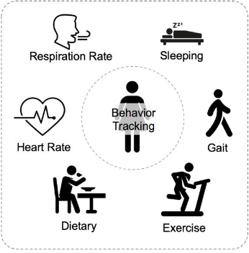


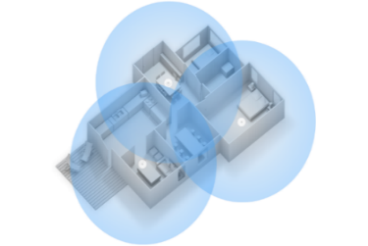
802.11bf WLAN sensing
WLAN sensing is the use of received WLAN signals to detect features of an intended target in a given environment.
    Measure range, velocity, angular, motion, presence or proximity
    Detect objects, people, animals: Enables touchless applications
    Use in room, house, car, enterprise environments
Target frequency bands are between 1 GHz and 7.125 GHz (MAC Service interface) and above 45 GHz (MAC/PHY)
Some use cases
https://www.cse.ust.hk/~qianzh/research/sensing-2.jpg
https://www.pressebox.com/pressrelease/gb-pronova-gmbh/HoloPro-and-the-magic-of-interactive-control/boxid/129647#
http://4.bp.blogspot.com/-_krIAHPdn-8/T02hISBvOnI/AAAAAAAAA1A/jAufr2N8k4c/s1600/Kinect%2BGames.jpg
https://www.lastampa.it/tecnologia/news/2018/06/27/news/router-google-wifi-internet-senza-fili-in-ogni-angolo-della-casa-1.34027426
Smart home
Gesture recognition
Gaming control
Presence and proximity detection (Home/Enterprise/Vehicle)
Note: The specification of applications that make use of WLAN sensing measurements is beyond the scope of P802.11bf.
35

Slide 36
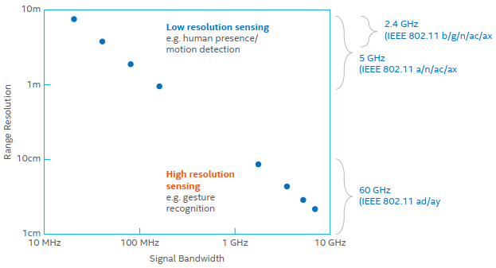
802.11bf WLAN sensing
802.11bf enables:
  Stations to inform other stations of their WLAN sensing capabilities
  Request and setup transmissions that enable WLAN sensing measurements to be performed
  Exchange of WLAN sensing feedback and information
Sensing performance metrics include
  Accuracy of range, angle and velocity resolution
  Resolution of range, angle and velocity
  Coverage range, field of view
36

Slide 37
802.11bh Randomized and Changing MAC addresses (RCM)
A MAC address is a physical hardware identifier that is assigned by the hardware manufacturer to a
network device (Ethernet, Wireless, and Bluetooth as examples)
To protect user privacy, there is a growing trend to randomize the client device’s MAC address, which
can otherwise be “snooped” by third-parties and used to track the user’s movements and potentially actions.
  MAC address randomization can undermine the network’s ability to steer the device to the best connection point, or to recognize the device and provide differentiated access in secure environments, pay-for-bandwidth scenarios, etc.
37

Slide 38
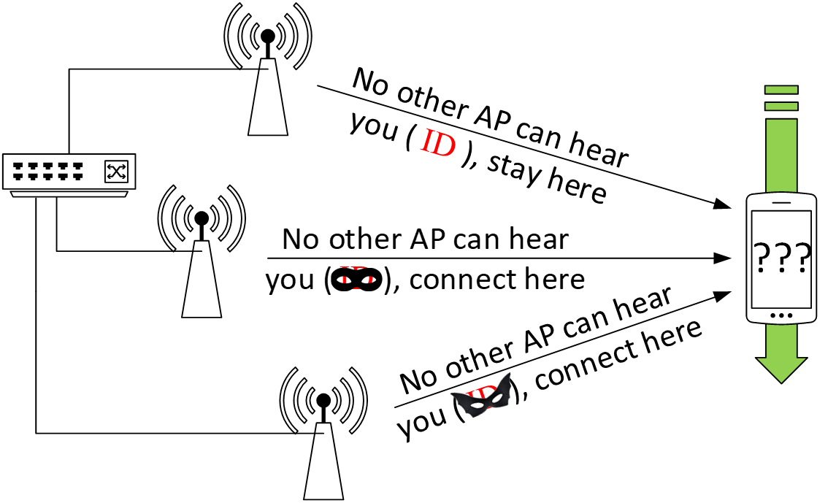
802.11bh Randomized and Changing MAC addresses (RCM)
Client Steering Use Case
  Impacted use cases include:
  Steering a client device to the best connection point
  Recognizing the device, to provide personalized home automation
  Access to pay services, or differentiated levels of service
  Customer support and troubleshooting
38
Notes:
Use cases in which use of a Randomized MAC address impacts network operation include
Steering a client, and following, as listed on the left.
The Figure shows the example Client steering use case, in which the network instructs the client device to stay
or connect to a particular AP. The network needs to be able to correlate the device’s communications (probes, etc), while at the same time, the identity is not
visible to passive observation.

Slide 39
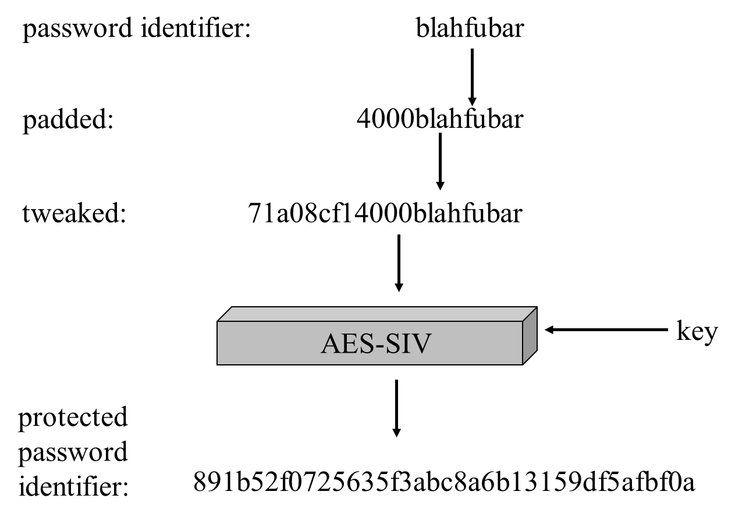
802.11bi Enhanced Data Privacy
Defines new mechanisms to improve user privacy
Today, IEEE Std 802.11aq-2018 defines MAC address randomization and specific requirements to prevent device tracking using passive observation of PHY, MAC protocol fields.
To ensure continued growth and support for IEEE Std 802.11, this project is investigating additional enhancements for user privacy solutions applicable to 802.11.
Privacy of Password (WPA3)
Privacy of Password Identifier
Figure: https://mentor.ieee.org/802.11/dcn/21/11-21-0541-00-00bi-protecting-password-identifiers.pptx
39

Slide 40
P802.11bk (TBC) 320 MHz Positioning
New project to further increase the accuracy of 802.11 based location and proximity determination
WLAN standardization roadmap towards 0.1m accuracy levels in real world scenarios
Based on P802.11be 320 MHz channelization and waveforms, reuses the 802.11be PHY
Takes advantage of WLAN spectrum availability in the <7GHz band and the superior 802.11 link budget
Attractive for device-to-device, improved self-locating network accuracy, keyless entry and engine-start use cases
Slide40

Slide 41




UHR SG: Ultra High Reliability Study Group was approved in July 2022 to define scope and purpose of next MAC/PHY project
Lower latency
Improved
manageability
The Study Group will investigate technology which may
improve reliability of WLAN connectivity,
reduce latencies,
increase manageability,
increase throughput including at different SNR levels, and
reduce device level power consumption
Goal: Task Group to start work in May/July 2023
Work beyond 11be
Reduced power consumption
Higher reliability
Longer Range
Higher Throughput
Baseline
Backwards Compatibility
Positioning

Slide 42
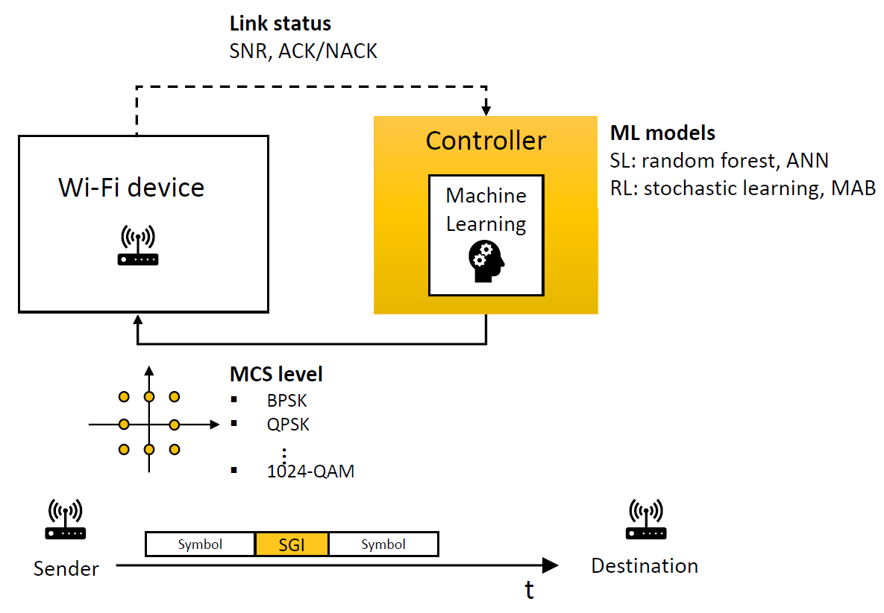
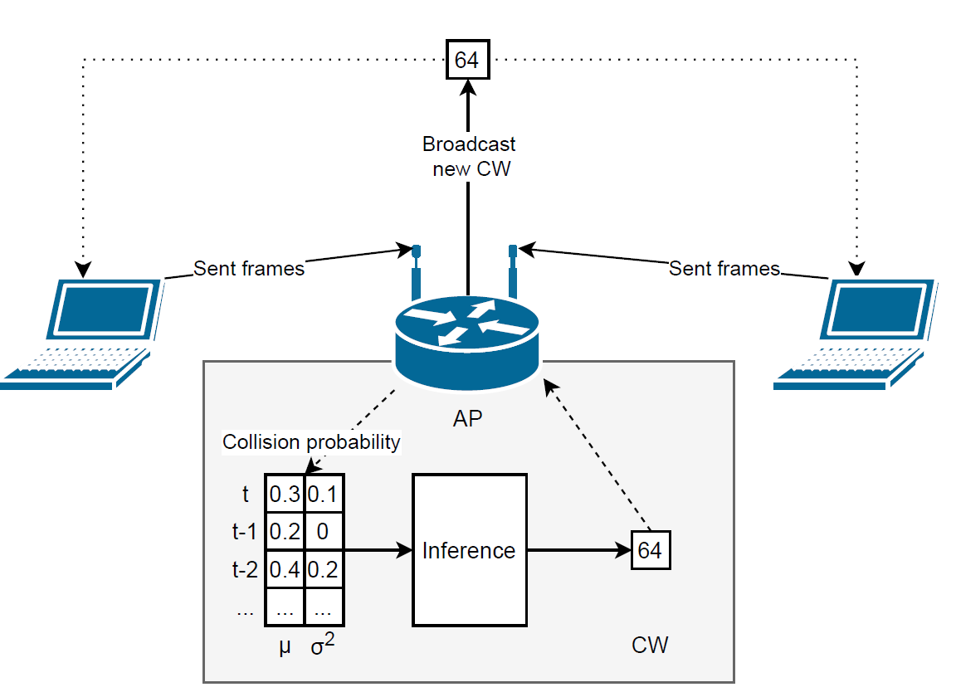
AIML TIG: Investigate WLAN support of Artificial Intelligence/ Machine Learning
  Use of AIML for 802.11 applications is an active area of work in the research community. See Applying ML to 802.11: Current Research and Emerging Use Cases
  Current applications focus on performance improvement parameter selection for channel access control and link adaptation, multi-user parameters, channel usage
  Focus of the 802.11 AIML Topic Interest Group is to
Describe use cases for Artificial Intelligence/Machine Learning (AI/ML) applicability in 802.11 systems and
Investigate the technical feasibility
of features enabling support of AI/ML.

Slide 43
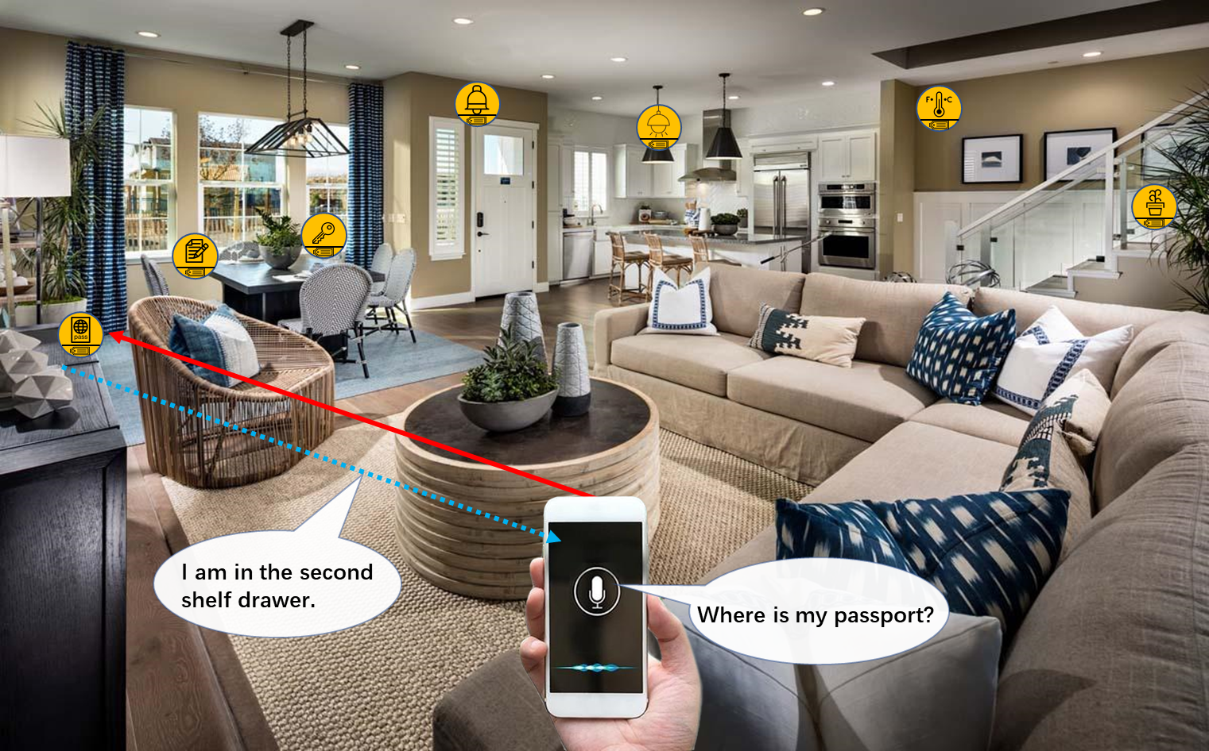

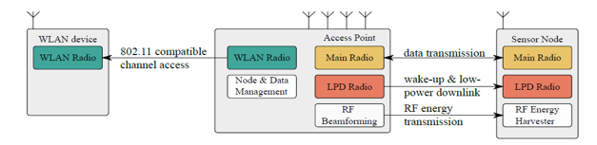

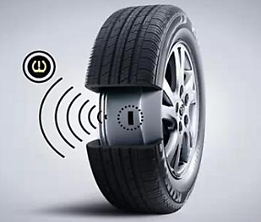
AMP TIG: Investigate WLAN support of Ambient Power
  Research into ambient power (energy harvesting) and prototype development has been ongoing using 802.11 based devices
  Optimizing M2M Energy Efficiency in IEEE 802.11ah, IEEE GLOBECOM 2015
  “the battery dependency of an 802.11ah sensor is significantly lowered by energy harvesting provided that the sensor size and energy harvesting efficiency are sufficient for the utilized ambient energy source.”
  Low-Power Downlink for the Internet of Things using IEEE 802.11-compliant Wake-Up Receivers, IEEE INFOCOM 2021
  Use Cases include Smart Home, Logistics/Warehouse/Inventory, Industrial Wireless Sensor Networks
See https://mentor.ieee.org/802.11/dcn/22/11-22-0645-02-0wng-ambient-power-enabled-iot-for-wi-fi.pptx

Slide 44
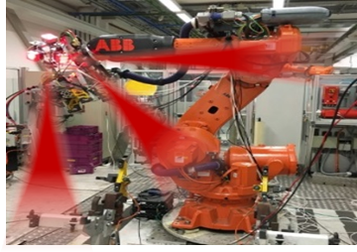

Summary: New 802.11 Radio technologies are under development to meet expanding market needs and leverage new technologies
802.11az – 2nd generation positioning features.
802.11ba – Wake up radio. Low power IoT applications.
802.11bb – Light Communications
802.11bc – Enhanced Broadcast Service
802.11bd – Enhancements for Next Generation V2X
802.11be – Extremely High Throughput in 2.4, 5 and 6 GHz bands
802.11bf – WLAN Sensing
802.11bh – Randomized MAC Addresses
802.11bi – Enhanced Data Privacy
802.11bk – 320 MHz Positioning (TBC)
Notes:
Here is a list of amendments currently under development.

Slide 45
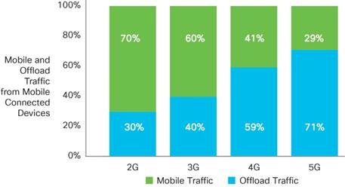
802.11ax (2.4GHz, 5(6)GHz), 802.11ay (60GHz), and 802.11ah (sub 1GHz) technology can be leveraged to meet 5G requirements
Today’s 4G networks include 802.11 technologies
  For offload: “More traffic was offloaded from cellular networks (on to Wi-Fi) than remained on cellular networks in 2019” (Cisco VNI)
  For Wi-Fi calling
Wi-Fi carries most public & private Internet traffic worldwide
  Between 50-80% depending on country.
5G radio aggregation technologies will natively incorporate Wi-Fi
  802.11/Wi-Fi is a Peer Radio Access Technology in the 5G Architecture
802.11ax
8Gb/s (OFDMA, U/L MU-MIMO)
5G Hotspot Mobile Broadband
802.11ay/aj
60GHz
n*20Gb/s (Aggregation+MIMO)
Device connectivity
802.11ah (Sub 1 GHz)
+ 11ba
900 MHz Indoor IoT PANs
Wearables, sensors, smart home

Slide 46
IEEE 802.11ax meets the MAC/PHY requirements for 5G IMT-2020 Indoor Hotspot and Dense urban test environments defined by ITU-R
Simulation conforming to the ITU-R evaluation methodology shows that performance of IEEE 802.11ax systems meet or exceed MAC and PHY requirements for the 5G Indoor Hotspot and Dense Urban test environments
 | Metric (Indoor Hotspot) | ITU-R Evaluation Method | Minimum Requirement | 802.11ax Performance
1 | Peak data rate | Analytical | DL/UL : 20/10 Gbps | DL/UL : 20.78 Gbps
2 | Peak spectral efficiency | Analytical | DL/UL : 30/15 bits/s/Hz | DL/UL : 58.01 bits/s/Hz
3 | User experienced data rate | Analytical for single band and single layer; Simulation for multi-layer | Not applicable for Indoor Hotspot | Not applicable
4 | 5th percentile user spectral efficiency | Simulation | DL/UL : 0.3/0.21 bits/s/Hz | DL/UL : 0.45/0.52 bits/s/Hz
5 | Average spectral efficiency | Simulation | DL/UL : 9/6.75 bits/s/Hz/TRxP | DL/UL : 9.82/13.7 bits/s/Hz/TRxP
6 | Area traffic capacity | Analytical | DL : 10 Mbit/s/m² | Required DL bandwidth = 170 MHz with 3 TRxP/site
7 | Mobility | Simulation | UL : 1.5 bits/s/Hz | UL : 9.4 bits/s/Hz
8 | Bandwidth | Inspection | 100 MHz, scalable | 20/40/80/80+80/160 MHz
9 | User plane latency | Analytical | DL/UL : 4 ms | DL/UL : 80 us
Notes:
In the 802.11 Working Group, simulations and analysis was performed to evaluate the performance characteristics of the standard using the ITU-R defined evaluation methodology.
The performance of the 802.11ax Wi-Fi 6 MAC and PHY meet or exceed the requirements for the 5G Indoor Hotspot and Dense Urban test environments.
802.11ax systems provide an excellent foundation for these indoor hotspot and dense urban applications.

Slide 47
802.11 is a Peer Radio Access Technology in 5G System
Untrusted WLAN Access (3GPP Rel-15 onwards)
Trusted WLAN Access (3GPP Rel- 16 onwards)
5G System is Access Agnostic: UE devices can register and access 5G services without the need of licensed based access;
Unified EAP based authentication mechanism for all accesses;
Unified transport mechanism over WLAN access for both trusted and untrusted use cases;
Policies based mechanism for access selection and traffic selection, steering and splitting;
Unified QoS mechanism for both cellular and WLAN access.

Slide 48
802.11 and cellular radio technologies are largely complementary in meeting the comprehensive 5G service vision
WLAN access is integral part of the into the 5G system architecture developed by 3GPP
5G architecture is a functional based architecture
  This provides the flexibility that both core network anchoring and the RAN based anchoring from 4G system are seamlessly supported in 5G system architecture
802.11 defined technologies – 2.4/5/6/60GHz and cellular radio technologies are essential – and largely complementary - in meeting the comprehensive 5G service vision

Slide 49
Thank You
Questions
Additional slides: Recently completed amendments, including IEEE Std 802.11ah-2016, IEEE Std 802.11ax-2021, IEEE Std 802.11ay-2021, and IEEE Std 802.11ba-2021

Slide 50

IEEE Std 802.11ah-2016 enables Wi-Fi for M2M and IoT applications
Long range indoor/outdoor connectivity up to 1 km
Robust connections for superior penetration through walls and other obstacles in home and industrial environments
Low power consumption for multi-year battery operation
Bidirectional monitoring and control of IoT client devices enable over the air software updates
Moderate data rates support IETF TCP/IP, discovery protocols
  WFA Wi-Fi Certified HaLow certification program
  Japan: 802.11ah Promotion Council
  New market entrants emerging to develop the technology
Bandwidth
PHY Rate
1
MHz
150Kbps – 4Mbps
2
MHz
650Kbps – 7.8Mbps
4 MHz
1.35Mbps – 18Mbps
8 MHz
2.9Mbps – 39Mbps
16 MHz
5.8Mbps – 78Mbps

Slide 51



802.11ah use cases are broad: Consumer, Industrial, Agricultural
Industrial Automation
  Smart robots with local imaging
Agriculture, Horticulture, City farming
  Large number of devices supported
  See http://www.methods2business.com/applications
Process Automation
  Predictive maintenance, logistics, inventory tracking
Healthcare in hospital and home settings
Home and Building automation
  Energy and asset management
  Remote operation/self diagnosis
  Whole home coverage for battery operated sensors
Retail: Electronic shelf labels
Notes:
The longer range and robust operation characteristics of 802.11ah technology enable support of a broad variety of use cases
Across consumer, industrial and agricultural applications.
<Read the list, comment on the agricultural applications>.

Slide 52

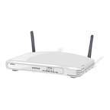
IEEE Std 802.11ax-2021 is focused on improving performance in dense environments
Existing 802.11 WLAN systems serve dense deployments: 2019 Super bowl: 24TB* of data carried on WLAN network
802.11ax aims to further improve performance of WLAN deployments in dense scenarios
  Targeting at least 4x improvement in the per-STA throughput compared to 802.11n and 802.11ac.
  Improved efficiency through spatial (MU MIMO) and frequency (OFDMA) multiplexing.
Dense scenarios are characterized by large number of access points and large number of associated STAs deployed in geographical limited region
  e.g. a stadium or an airport.
  * https://www.extremenetworks.com/resources/slideshare/wi-fi-engagements-from-super-bowl-liii/
Access to Internet, latest airlines’ announcements, and digital media such as movies and sport events
Notes:
Reference: https://www.extremenetworks.com/resources/slideshare/wi-fi-engagements-from-super-bowl-liii/
AX is the next major MAC PHY that will come to the market. Already some products R&D announced. More be shipped and certified in 2019
Primary goal of 802.11 AX is to improve the performance of wireless LANs in dense scenarios. Targeting at least 4x improvements in the throughput per client device over 802.11n and ac.
Technologies used are MU-MIMO and OFDMA

Slide 53
IEEE Std 802.11ay-2021 defines next generation 60 GHz: increased throughput and range
20Gbps+ rates are defined
License- Exempt bands above 45Gbps
Completion in 2021; First chipsets announced
Use Cases:
  Ultra-Short Range
  8K UHD - Smart Home
  AR/VR and wearables
  Data Center Inter Rack connectivity
  Video / Mass-Data distribution
  Mobile Offloading and MBO
  Mobile Fronthauling
  Wireless Backhauling (w. multi-hop)
  Office Docking
  Fixed Wireless
Key additions :
  SU/ MU MIMO, up to 8 spatial streams
  Channel bonding
  Channel aggregation
  Non-uniform constellation modulation
  Advanced power saving features
53

Slide 54
60 GHz Fixed Wireless Use Case: Affordable 5G Performance
“the 14 GHz of contiguous spectrum in the band offers more bandwidth than any other licensed or unlicensed mmWave band. Further, the 60 GHz band has chipsets and technology currently available on the commercial market.”
“In the U.S., unlicensed mmWave frequencies available for 5G primarily cover the band from 57 – 71 GHz, called the V-Band, or 60 GHz band. This band offers 14 GHz of contiguous spectrum, which is more than all other licensed and unlicensed bands combined7. This makes the 60 GHz band an excellent alternative to licensed mmWave frequencies for smaller providers, as it can be used to deliver 5G performance for the minimal cost of available 60 GHz infrastructure products.
https://go.siklu.com/hubfs/Content/White%20Papers/Maravedis%20Industry%20Overview:%205G%20Fixed%20Wireless%20Gigabit%20Services%20Today.pdf
https://www.fiercewireless.com/wireless/60-ghz-band-particularly-appealing-for-fixed-wireless-report

Slide 55

60 GHz Mesh Backhaul Wireless Use Case: Deploying Today
“Leading Wi-Fi and wireless network solution vendor Cambium Networks announced today that they will be incorporating Facebook’s Terragraph technology into a new series of Cambium Networks 60 GHz radio products called cnWave™. The news comes as Terragraph appears to be ramping up go-to-market activities with trials underway in Hungary and most recently in Malaysia.”
“Terragraph is essentially a 60 GHz-based meshed (or multi-hop, multi-point) backhaul radio system for deployment at street level in cities.”
https://wifinowevents.com/news-and-blog/cambium-networks-to-incorporate-facebook-terragraph-tech-into-new-60-ghz-products/
June 2022

Slide 56
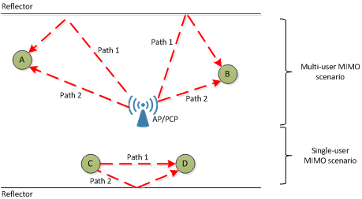
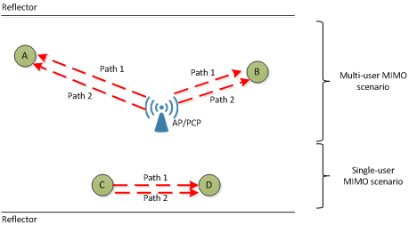
802.11ay builds on 802.11ad with MIMO and channel bonding features
Example without polarization
Channel bonding and aggregation requires new:
  Channelization
  Packet format
  Channel access mechanisms
Single User and downlink MU MIMO
  Distribute capacity across users
  Unique requirements given directionality
  Exploit antenna polarization
  Changes to the beamforming protocol
Example with polarization

Slide 57
802.11ay defined channelization

Slide 58
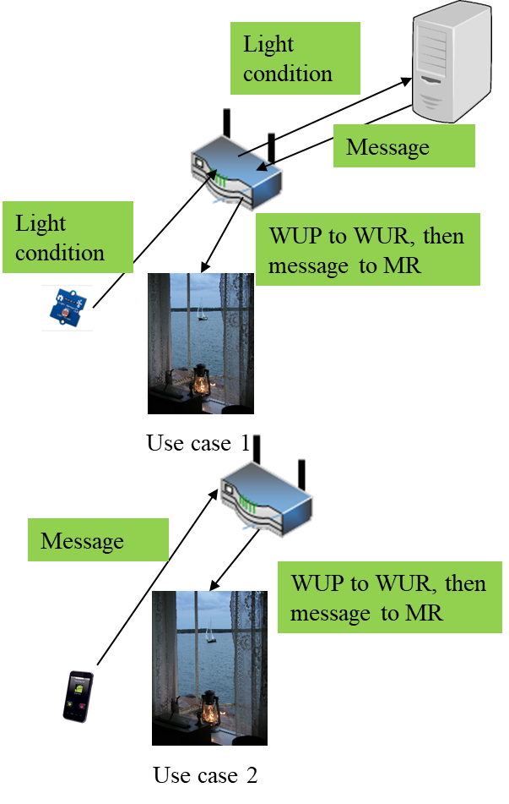
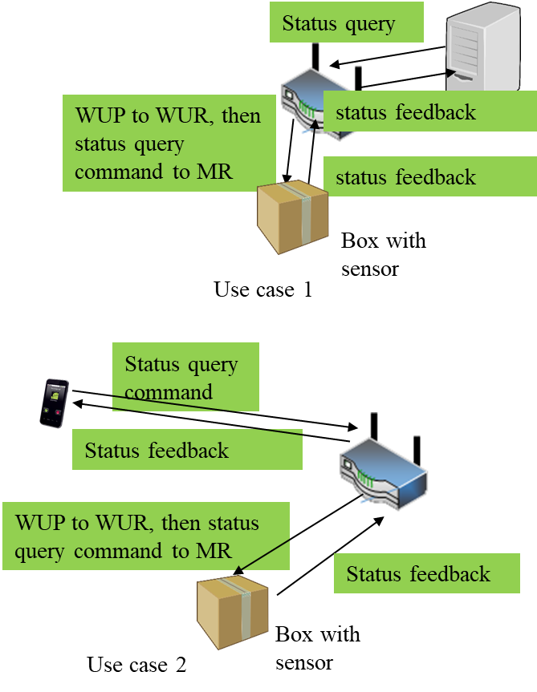
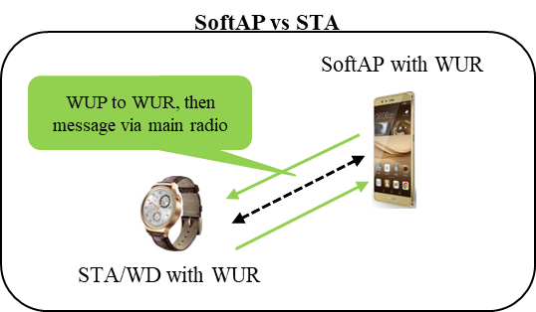
IEEE Std 802.11ba-2021 Wake-up Radio Main Use Cases
1. Smart Home
2. Warehouse
3. Wearables
WUP: wake-up packet
WUR: wake-up receiver
MR: main radio

Slide 59


802.11ba improves energy efficiency of stations and maintains low latency
Internet
Internet
AP buffers data until the 802.11 station wakes up
→ Long latency
data
Buffer
data
Do you have data for me?
Buffer
Do you have data for me?
No
Do you have data for me?
802.11 radio needs to wake up periodically to receive data within a latency requirement → high power consumption of 802.11 station
No
No
Awake
Awake
802.11 station
802.11 station
Sleep
Sleep
Short sleep interval
Long sleep interval
June 2022
Notes:
802.11ba focuses on improving the power efficiency of 802.11 stations, enabling longer batter life.

Slide 60
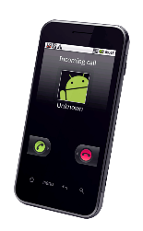

802.11ba Low Power Wake-up Radio Operation
Transmission range
or
Data
Packet
802.11 = LP-WUR
Transmitter
Receiver
802.11
802.11
802.11
802.11
ON
OFF
OFF
+
ON
802.11
Wake-up
Packet
Wake-up signal
LP-WUR
ON
Wake-up
Packet

